Slide 1
IMDB Database
Section 04 Group 9
-Akshay Jain
-Ayushi Sachdeva
-Vinay Gor

Slide 2
Introduction
The Internet Movie Database (abbreviated IMDb) is an online database of information related to films, television programs including cast, production crew, fictional characters, biographies, plot summaries, trivia and reviews, operated by IMDb.com, Inc., a subsidiary of Amazon.com.
Project Objective
Design and populate IMDB database using the web or mobile interface.
Identify and create entities and relationships
Creation of ER model for entities and relationships identified in design
requirements.
List of tables and columns and insertion of values and corresponding contraints on it.
List of queries IMDB user might be searching for when using IMDb application

Slide 3
Toad Data Model

Slide 4
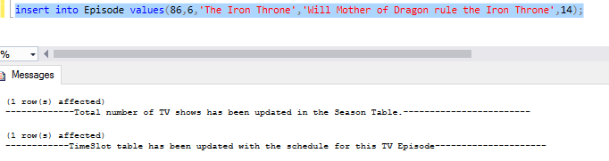
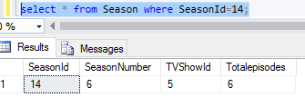
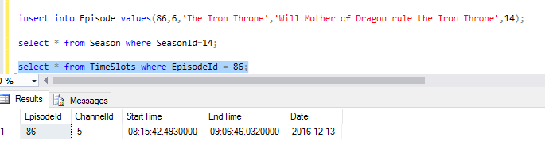
Challenges Solved:
1) Trigger for Episode table which will update Timeslot and Season table once an entry is inserted in Episode table

Slide 5
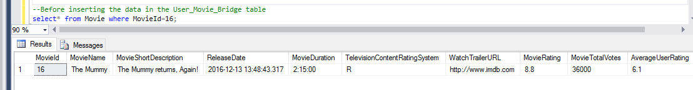
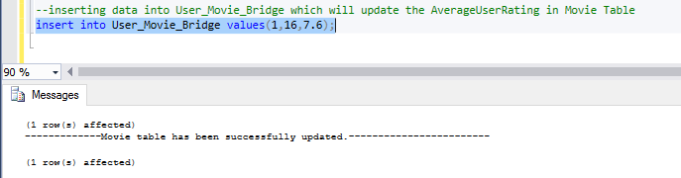
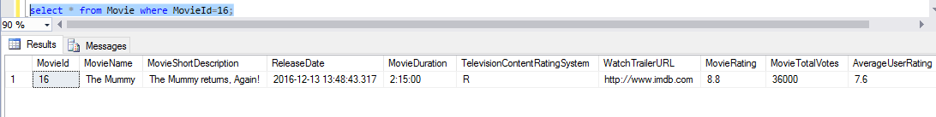
2) Trigger for User_Movie_Bridge table which will update Average User rating in Movie table once an entry is inserted in User_Movie_Bridge table

Slide 6
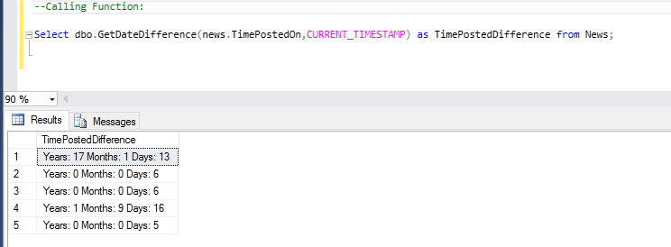
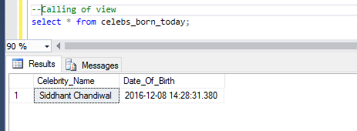
3. a) Function to get the date difference from the current date in the format of Year, Months and Days
3.b) Function to get the list of Celebrities born on any given day

Slide 7
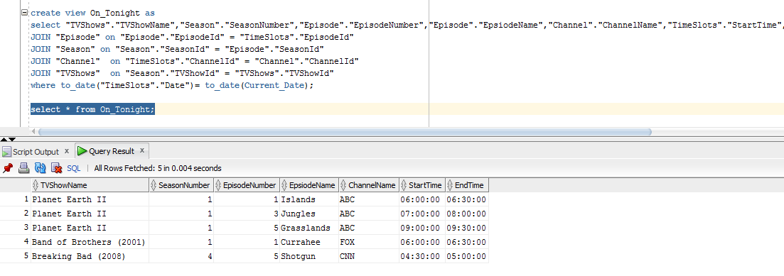
4) View for On_Tonight

Slide 8
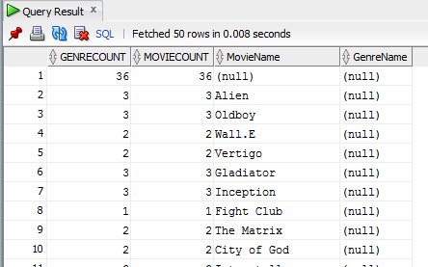
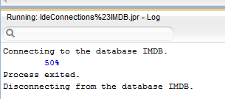
5) Displaying list of movies with their Genres and Count
6)Function to Calculate Award Winning percentage for Movies, TV Shows, Celebrities, Writers and Directors

Slide 9
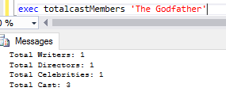
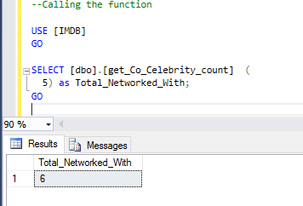
7) Procedure to get the total cast members in a movie
8) Find the Total Number of TV-Co-actors an Actor worked with

Slide 10
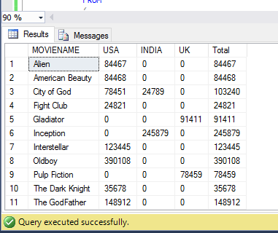
9) Display the Movie Gross Collection in each Country and the Total Gross Collection

Slide 11
Thank you for your time.

